Slide 1

HR ANALYSIS DASHBOARD PROJECT

Slide 2
Team Members
01
04
Omar Eissa Ibrahim
Rawda Raafat Ramadan
02
05
Omar Mahmoud Kamel
Maryam Ahmed Salah El-Din
03
06
Diana Adel
Habiba Ragab Mohamed

Slide 3
PROJECT OVERVIEW
This project focuses on analyzing Human Resources data to better understand workforce patterns and organizational dynamics. The aim of the project is to explore employee-related data, identify meaningful trends, and extract insights that can support more informed HR decisions.
The analysis involves collecting and preparing HR data, examining key factors such as employee demographics, department distribution, hiring trends, and attrition rates. By studying these aspects, the project highlights patterns that may influence employee retention, workforce planning, and overall organizational performance.
The final outcome of the project is an analytical dashboard that presents these insights in a clear and visual format, making it easier for stakeholders to interpret the data and use it to guide strategic HR decisions.

Slide 4

PROJECT AGENDA
02
04
06
Data Modelling
Visual Sample
Dashboard
01
03
05
Data Processing
DAX
Report

Slide 5
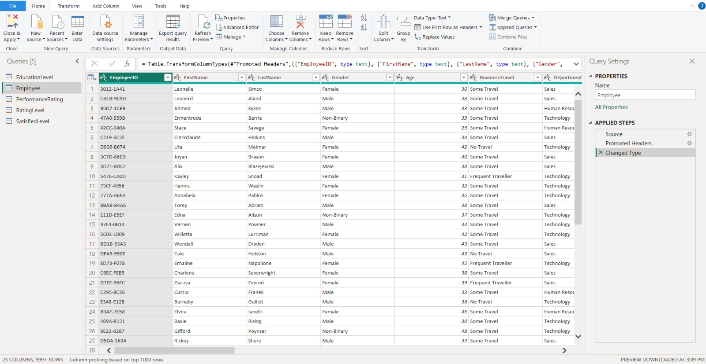


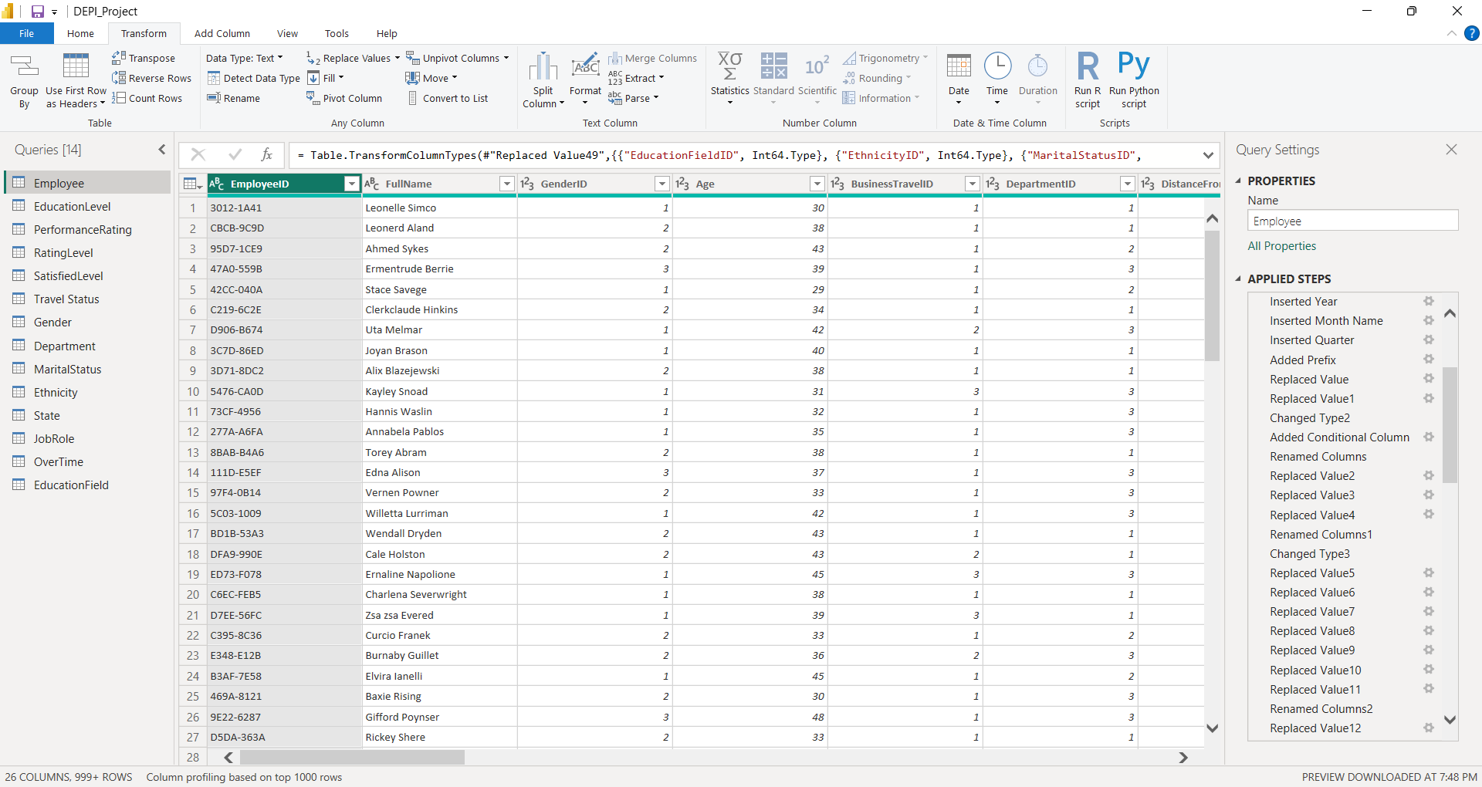
Data Processing
01

Slide 6
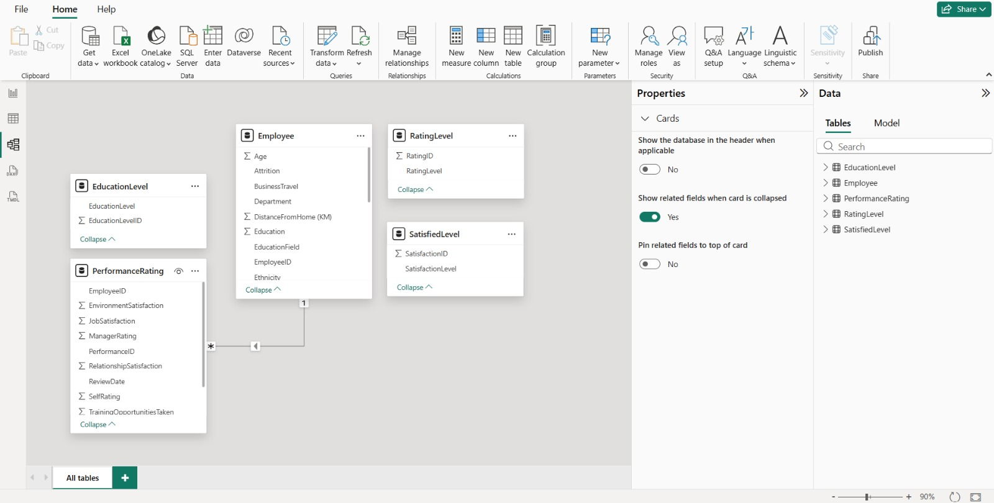
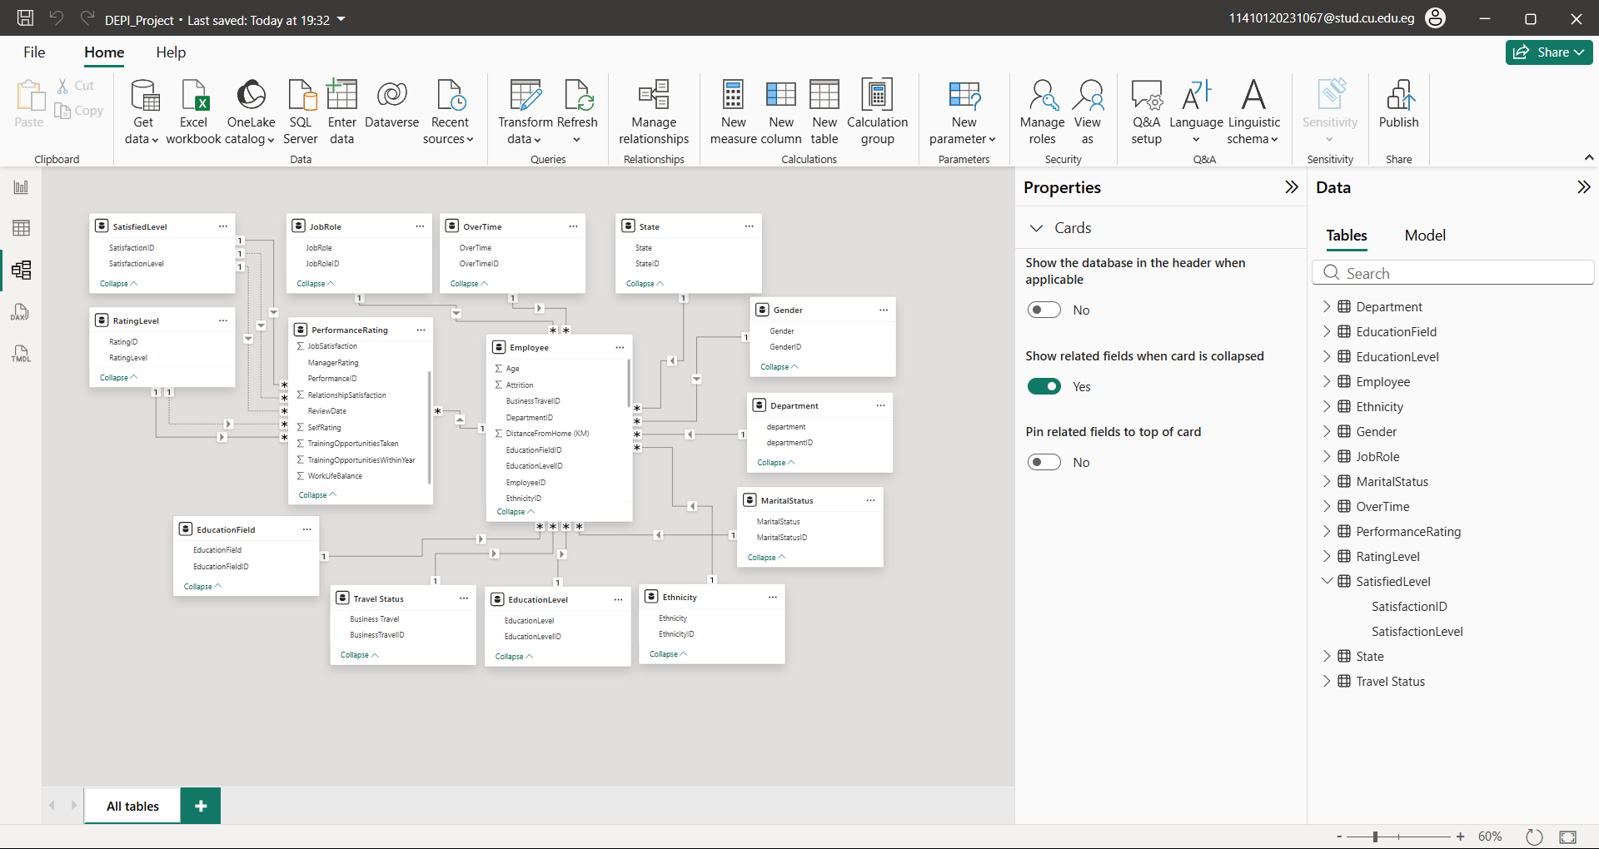
Data Modeling
02

